Slide 1

Smart Karshak
Smart Karshak
A hardware – software solution to operate Agriculture motor based on IoT Technology.

Slide 2

Smart Agriculture using IoT
Smart Karshak

Slide 3

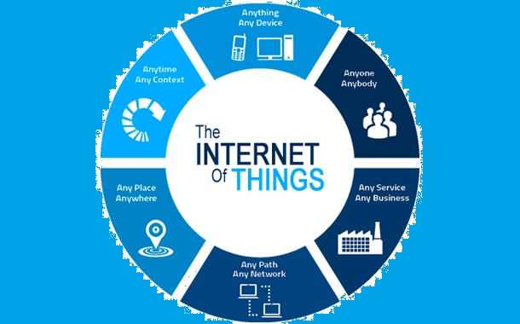

What is IoT?
Smart Karshak
IoT is short for Internet of Things.
The Internet of Things (IoT) is inter – Networking of physical devices. This system has ability to transfer data over a network without requiring human – to – human or human – to – computer interaction.

Slide 4
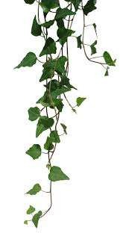
Why IoT?
IoT has many applications in agriculture, smart cities, smart home, healthcare, business sectors, Traffic monitoring, Transport and logistics etc.,
This is growing mega trend that will influence everything from business to our daily personal lives.
Here we are mainly focussing on agriculture as it plays a vital role in development of our country’s economy.

Slide 5
What is Smart Karshak?
Smart Karshak
This is a hardware – software solution consisting of :
An Hardware installed in the field and connected to motor.
Generic WiFi enabled internet service is provided to connect the hardware.
An android app installed in the Smartphone – connected to the hardware installed in the field.

Slide 6
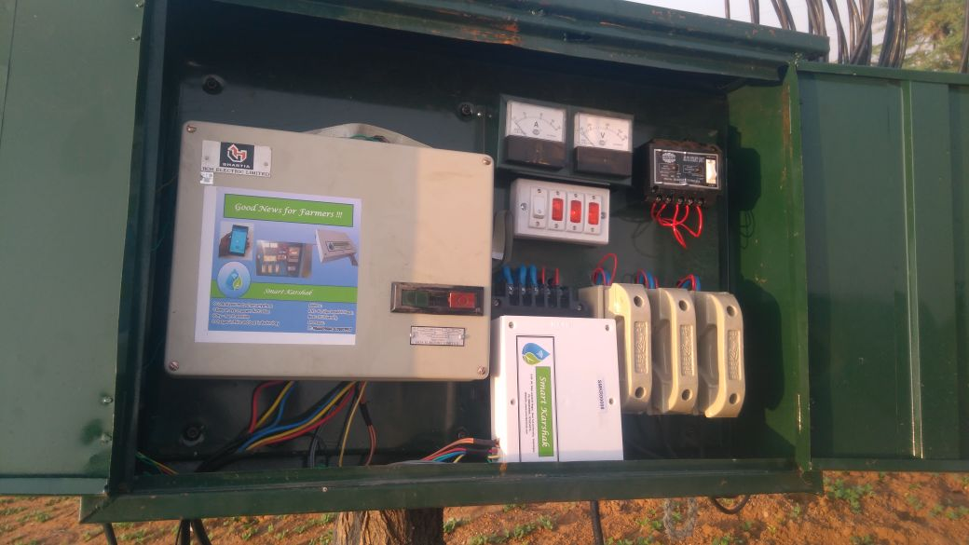
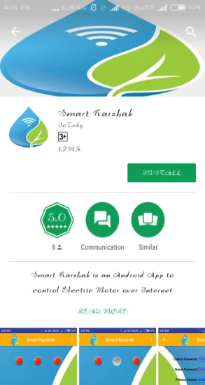
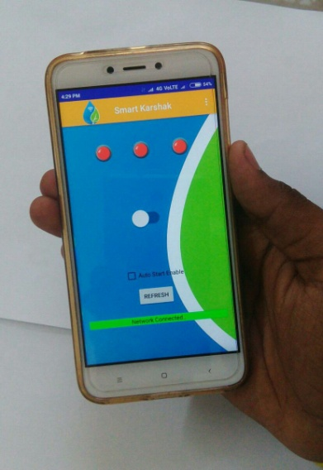
Install Hardware at field (internet router included)
Install “Smart Karshak” app from Play store
Change the user settings to pair the hardware and run the motor using Smart Karshak
Procedure

Slide 7
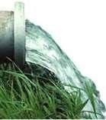
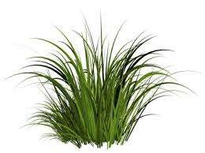
Features :
Control your motor from any where.
Keep an eye on power fluctuation and protection against various power failures.
Notifications on Power updates.
Auto Run facility
Cheaper in Price, Best in Technology.

Slide 8
Advantages
Cost Effective Method.
The effort of the farmers to operate motor manually is reduced.
Superior to auto starter technology
Better than SMS and IVR based technology.
Secured and protected over internet threats.

Slide 9
THANK YOU !
Smart Karshak
For more information regarding Smart Karshak, you can contact us at:
Email: info@smartkarshak.com
Tel: +91 986 665 9884 | +91 832 807 9937

